Slide 1
The Role and Impact of Midwives in New Jersey
Trinisha Williams, MPH, LM, CM, FACCE
President of American Association of Birth Centers

Slide 2

Introduction & Midwifery Snapshot in New Jersey
Midwives play a vital role in New Jersey’s maternity care landscape.
Over 250 licensed Certified Nurse-Midwives (CNMs) and Certified Midwives (CMs) currently practice in New Jersey.
Data on CPM’s is not available
Midwives attend approximately 8–10% of all births in New Jersey hospitals—a figure that is steadily increasing, especially in birth centers and out-of-hospital settings.
Despite their proven impact, midwives remain underutilized compared to other states and international standards.
This presentation will explore the types of midwives, challenges faced in NJ, and the impact of midwifery on maternal and infant health outcomes.

Slide 3
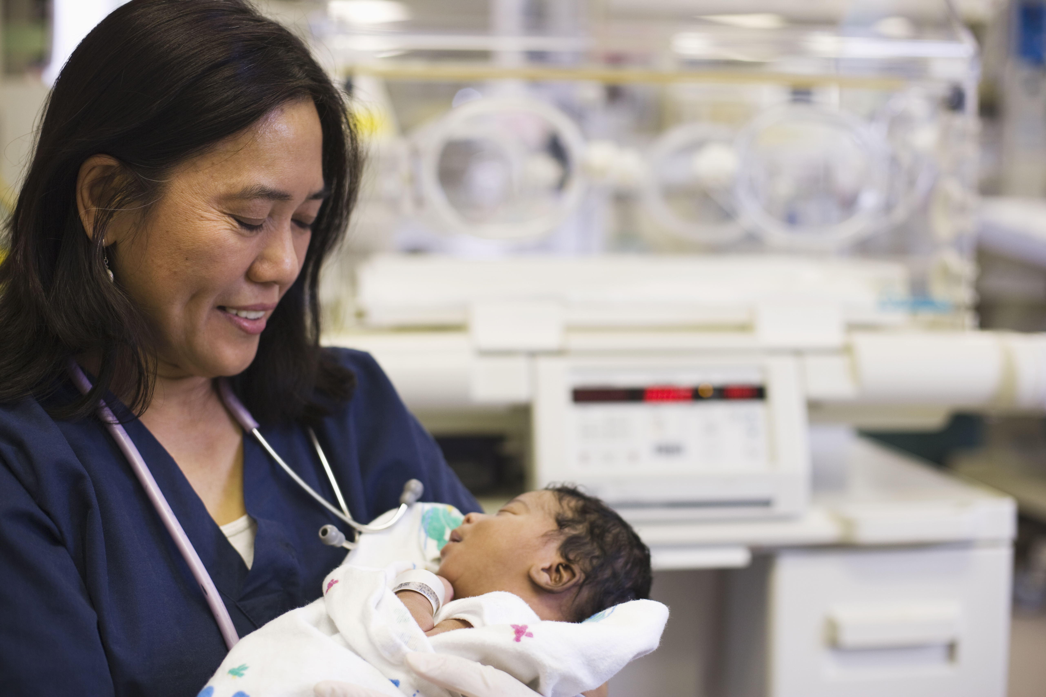
Types of Midwives in NJ
Certified Nurse-Midwives (CNMs): Registered nurses with advanced training Licensed to practice in all settings
Certified Midwives (CMs): Similar to CNMs, but not required to be RNs Licensed in select states, including NJ
Certified Professional Midwives (CPMs): Trained for out-of-hospital births Not licensed in all states; limited practice in NJ
Traditional/Direct-Entry Midwives: Non-nurse, apprenticeship-trained Not recognized/licensed in NJ

Slide 4

Scope of Practice
CNMs and CMs:
Full-scope reproductive, pregnancy, birth, and postpartum care
Prescriptive authority
Hospital, birth center, and home birth privileges
CPMs:
Primarily home and birth center births
Limited legal recognition in NJ

Slide 5
Midwifery in NJ – By the Numbers
Over 200 licensed CNMs/CMs in NJ
Midwives attend ≈10% of all births in NJ (higher in birth centers)
2022: 3 freestanding birth centers in NJ
NJ maternal mortality rate: ≈24.1 per 100,000 live births (higher than US average)
Racial disparities: Black women 3-4x more likely to die from pregnancy-related causes

Slide 6

Impact of Midwives on Maternal & Infant Health
Lower rates of cesarean birth, preterm birth, and low birth weight
Higher rates of breastfeeding initiation
Improved patient satisfaction and culturally competent care
Evidence: Midwifery-led care associated with lower maternal and neonatal morbidity

Slide 7

Challenges Facing Midwives in NJ
Regulatory Barriers:
Limited licensure for CPMs
Hospital privileging challenges
Reimbursement Issues:
Lower Medicaid/private insurance reimbursement
Birth center services often not fully covered
Workforce Shortages:
Aging workforce, limited training slots
Systemic Racism & Bias:
Disparities in care and outcomes
Underrepresentation of midwives of color

Slide 8

Addressing the Challenges
Advocacy for expanded licensure and practice authority
Increasing Medicaid and insurance reimbursement
Supporting midwifery education and pipeline programs
Promoting diversity and anti-racism in midwifery
Expanding birth center access

Slide 9

The Future of Midwifery in NJ
Growing demand for physiologic, patient-centered birth
Policy momentum for birth center expansion
Opportunities for collaboration with OBs, doulas, and community health workers
Midwives as leaders in addressing maternal health disparities

Slide 10

Conclusion & Call to Action
Midwives are essential to improving maternal and infant health in New Jersey.
Believed Birth 50/50: Join the movement to ensure that by 2030, 50% of all births in New Jersey are attended by midwives or take place in midwifery-led models of care.
Support Legislative Change:
S1097/A5609: Requires Medicaid coverage for homebirth and birth center care, expanding access for families across New Jersey.
Midwifery Licensing Act (A5527/S4487): Establishes a Board of Midwifery and supports independent midwifery practice statewide.

Slide 11

Resources
https://www.nature.com/articles/s41431-021-00882-1
https://onlinelibrary.wiley.com/doi/full/10.1111/pan.14064
New Jersey Board of Nursing.
For the number of licensed CNMs/CMs: NJ Division of Consumer Affairs, Board of Nursing
New Jersey Department of Health, Center for Health Statistics.
For birth attendance by midwives and birth center data: NJ Vital Statistics Annual Report
New Jersey Maternal Mortality Review Committee (NJMMRC) 2022 Report.
For maternal mortality rates and racial disparities: NJ Maternal Mortality Review Committee Report
American Association of Birth Centers (AABC).
For the number of freestanding birth centers: AABC Birth Center Directory

Slide 12
Thank you
Trinisha Williams, MPH, CM, LM, FACCE
917-375-1763
midwifeinthecity@gmail.com
IG Midwifeinthecity
www.midwifeinthecity.love

