Slide 1
New Jersey Counts 2020
Notes:
Welcome!
ACNJ is coordinating the statewide, non-profit Census outreach effort.
Though we are looking at Census issues broadly, we are also focused on the undercount of young children. Today’s presentation will address some of the issues relating directly to children under age 5.

Slide 2
YOU can be a Census Ambassador!
Download and print this toolkit to share with the families you serve.
Spread the word on why the Census matters.
Notes:
The goal for today is for everyone to become a “Census Ambassador.” As a group that regularly interacts with families with young children, you have an opportunity to share information. Feel free to download, print and photocopy the materials in this binder to distribute to the families you serve.
Consider the different networks you are a part of--both professionally and personally--and think of ways you can share messages about the Census. Groups like houses of worship, community service organizations, clubs, etc, are all useful outlets to tap into to spread information about the Census.

Slide 3
Topics for Today:
Census 101
Census Operations
Challenges to a Complete Count in NJ
Young Child Undercount
How to Get Involved
Wrap-Up
Notes:
Here is the rough layout for today’s presentation.
First, we will give you some background on the Census--what it is and why it is important.
Then, we will discuss some of the more technical aspects of Census operations--when they will start, what the form will look like, etc.
Then, we will start to talk about some of the difficulties in obtaining a complete count--both for the population at large and for young children.
We will then break for questions and then we will jump into a discussion of what you as early childhood professionals can do to ensure young children are counted.
Finally, we will wrap up with a quick exit survey to get your feedback on today’s training.

Slide 4
Census 101
What is the Census? Why is it important?
Notes:
Let’s begin with some background on the Census

Slide 5
What is the Census?
The U.S. Census is a national survey conducted every ten years by the U.S. Census Bureau to count EVERY living person in the United States.
People of all ages, races and ethnic groups, including citizens and non-citizens, must be counted.
Notes:
Many of you have probably heard of the Census.
It is a constitutionally mandated count of every person living in the United States. Citizens, non-citizens, individuals who were formerly incarcerated, children...everyone. The count is conducted by the U.S. Census Bureau.

Slide 6
Why is the Census Important?
The Census is so much more than just a head count. Its results will impact New Jersey for the next ten years.
Distribution of more than $22.7 billion in federal funds within NJ annually to support important programs and services like Medicaid, Head Start, schools, hospitals, roads and more.
Helps determine New Jersey’s number of seats in the house of representatives, its number of votes in the electoral college and our voting district boundaries.
Notes:
So, you know about the Census. But why is it important?
There are several different reasons. First, Census data are responsible for allocating billions of federal funds for important federal programs. More on some of those specific programs on the next slide.
Census data are also used to determine our governmental representation in Congress, the number of votes we have in the electoral college and how our voting districts are drawn. So, Census data determines political power.
Not listed on this slide, but equally important:
Data are used for important planning purposes—we need to know where populations are growing so we can build more schools and highways.
And the traditional use—and how ACNJ uses Census data in our Kids Count work—these data show us important details about the communities in which we live.

Slide 7
Annual Federal Funding Received by NJ:
NJ FamilyCare*: | $9.6B
SNAP: | $1.2B
Section 8 Housing Vouchers: | $741M
Special Education Grants: | $370M
National School Lunch Program: | $261M
Head Start: | $164M
WIC: | $151M
Child Care: | $120M
$22.7 Billion
many more federal programs
*Includes Medicaid and State Children’s Health Insurance Program (SCHIP)
Notes:
As we mentioned before, NJ received 22.7 billion dollars through important federal programs in FY 2016. And here is just a snippet of some of the programs who rely on Census data to allocate funds. Medicaid, SNAP, Special Ed. Grants, Head Start, etc. These are important federal programs that primarily impact children and they all depend on Census data.
If you’d like to see a longer list of programs, search for Andrew Reamer’s Counting for Dollars 2020, a project out of George Washington University, and look for the NJ fact sheet.

Slide 8
Census Operations
What questions will be asked?
When will I receive my questionnaire?
Notes:
Now you know a bit more about the Census--but I’m sure you have some technical questions. Like, what will the questionnaire look like, and when will I receive it?

Slide 9
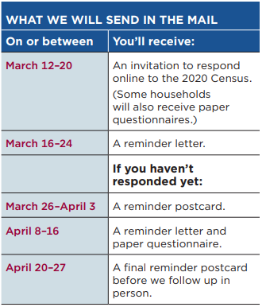
How Do I Complete My Questionnaire?
There will be three ways to complete the Census:
Online (including with a mobile device)
Over the phone
By mail
Notes:
2020 will mark the first year that respondents can complete their questionnaires online. On the right is a breakdown of the different types of mailings that will go out in the spring. Please note, the preferred method for Census completion will be online. With the exception of a few households, most homes will NOT receive a paper form until they have failed to respond to several mailed reminders from the Bureau. Alternatively, respondents can also complete their questionnaire over the phone.

Slide 10
Census Operations Timeline
March 2020
April 2020
May 2020
June 2020
July 2020
Invitations will be sent to households with instructions on how to complete the questionnaire online or over the phone.
April 1st, 2020 is Census Day. Households should complete their questionnaires by the end of this month.
The Census Bureau begins visiting homes in person that haven’t responded online, over the phone or by mail.
The Census Bureau continues to visit homes who haven’t responded.
July 31, 2020 concludes Census field operations.
Encourage households to respond before the end of April 2020 to lessen the chances of a Census worker following up in person.
This period is known as self-response.
Notes:
Here is a rough timeline of peak Census operations. Beginning in early March, instructions will be mailed to households on how to complete the Census online or over the phone. There will be a series of subsequent reminders sent from March through April to homes that have not responded. Homes that do not respond right away will eventually receive a paper form in the mail.
April 1, 2020 is Census Day--an important reference point for the Bureau. It is recommended that families and households try to complete their questionnaires before the end of April. This is the best way to reduce the likelihood of a Census worker visiting them in person to collect their responses.
Then, beginning in May, Census workers will begin to canvas neighborhoods. This work will continue into July.
It is important to message to families, if they would prefer not to have a Census worker visit their home, they should complete their questionnaire online or over the phone before the end of April. This will reduce their chances of an in-person visit.

Slide 11
Door-to-Door Census Enumerators
Beginning in May, Census takers might be in your neighborhoods in order to follow up with households that have not responded.
How can you recognize a Census worker?
Census workers will wear a photo ID with:
a U.S. Dept. of Commerce watermark
an expiration date
If you are ever unsure, contact the Census Bureau at 800-923-8282.
Notes:
Families should be informed that they may see Census workers canvassing their neighborhoods from May-July. They should know that Census workers will always wear a photo ID with an expiration date and a special U.S. Dept. of Commerce watermark.
If folks are concerned, contact the Census Bureau.

Slide 12
What Will The Census Ask?
Filling out the 2020 Census will be fast and easy!
The survey will take about 10 minutes to complete
Will collect basic information about you and your household:
For each household member:
Name
Age/date of birth
Gender
Racial/ethnic background
Relationship to head of household
Other questions:
Owner/renter questions
Notes:
The Census Bureau is framing this as something that is fast and easy to complete. The questionnaire should take about 10 minutes and it can be done on your own schedule.
The survey will ask basic questions--like your name, age, gender and race--of all residents within the household.

Slide 13
What WON’T the Census ask?
U.S. Census Bureau will NEVER ask for your:
Social security number
Money
Donations
Bank and credit card information
Beware of Scams!
If you suspect a scam, contact the U.S. Census Bureau. A local Census respresentative can be reached at: 800-923-8282.
Notes:
It is important to note--the Census Bureau will NEVER ask for personal financial information. If you receive something in the mail that appears to be from the Bureau, but it is asking for your social security number or is saying you need to mail a check, do not follow its instructions. This is a SCAM and should be reported to the Bureau immediately.

Slide 14
Language Support
In addition to English, people can respond to the Census online or by phone in 12 different languages:
Spanish
Chinese
Vietnamese
Korean
Russian
Arabic
The paper form will be available in English and Spanish.
Tagalog
Polish
French
Haitian Creole
Portuguese
Japanese
Notes:
It goes without saying that language support will be crucial for the upcoming Census. Nearly 1/3 of NJ residents speak a language other than English.
There will be online/phone support in 12 major languages—however, we all know that there are many more languages that are spoken out there. This is why coordinated local responses are important, which we will begin to discuss in the second portion of this training.
And the hard copy form will only be available in English or Spanish.

Slide 15
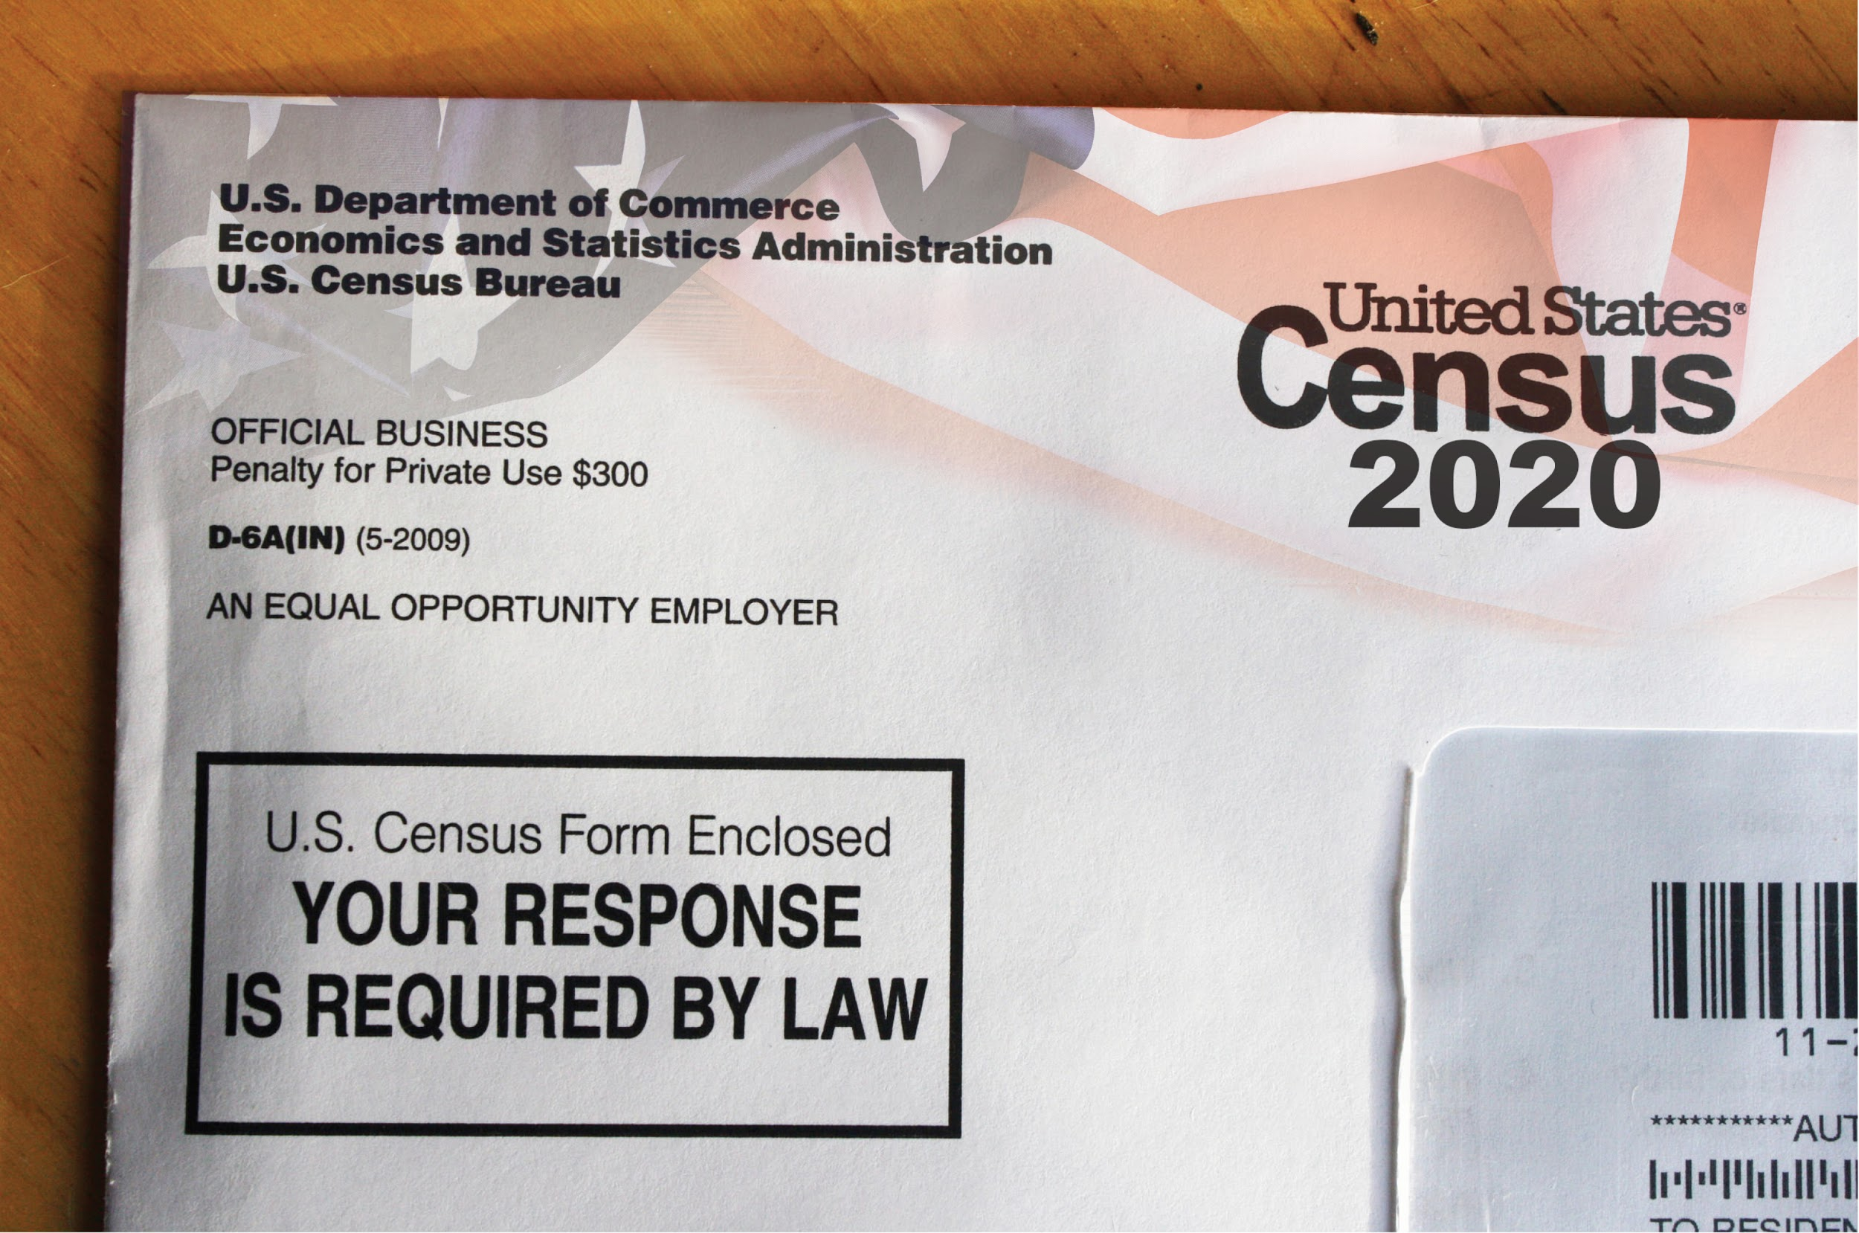
Questions?
What we have covered so far:
Census 101
Census Operations
Notes:
Let’s take some time to answer any questions you may have. Just to recap, here are the subject areas we have covered so far.

Slide 16
Challenges to a Complete Count in NJ
What is a hard-to-count (HTC) group?
Where are HTC groups concentrated?
Notes:
You may have heard that young children are hard to count, but you may not know the technical definition of HTC. We will cover that in this next portion.

Slide 17
Specific Challenges for 2020 Census
First Census to be primarily filled out online or on the phone
Distrust of government
Fewer staff than 2010 for in-person follow-up/coordination
Concentrations of hard-to-count populations throughout NJ
Notes:
While there are barriers to a complete count during every Census year, there are some specific obstacles for 2020.
As mentioned earlier, this is the first year that the Census will be able to completed online, and we know that many New Jerseyans are without internet or have limited access to internet.
There are also several other factors--an erosion of trust in the federal government along with mistrust of government surveys. There are fewer staff and resources for this Census than in 2010. And we also know that there are “hard-to-count” populations throughout our state.

Slide 18
NJ Hard-To-Count Groups
A Hard-To-Count (HTC) population refers to areas where a low percentage of households returned their 2010 Census forms.
Some populations are harder to count than others...
Children under 5
People of color (African Americans, Latinx, Asian Americans)
Non-English speakers
Immigrants
Renters
Notes:
What is a hard-to-count population? We are able to identify different neighborhoods, cities or counties as HTC based on response rates to the 2010 Census. This isn’t a perfect science, as some areas have changed a great deal since 2010--but it’s a useful tool in identifying areas that might be at a greater risk of an undercount.
Some populations that are considered HTC are young children, people of color, immigrants, individuals who are highly mobile and renters.

Slide 19
What are the barriers to a complete count?
Some reasons people are missed in the count are:
They speak a language other than English
They mistrust or are fearful of the government
They live in a “complex household”
Their address wasn’t listed (think: multi-unit buildings)
They were not included on their household form
Notes:
The reasons some folks are missed in the Census count can be complicated, but some of the most common reasons include: language barriers and fear/mistrust of the government. These first two are more or less self-explanatory.
They may live in a complex household, which we will explain in further detail. Another reason may be because their address wasn’t listed--think of apartment buildings with an unregistered basement apartment. That address doesn’t technically exist, and may never receive a mailer.
And lastly, but most important for young children--some people are left of the form entirely by other members of their household.

Slide 20
Young Child Undercount
In New Jersey, 27,000 children (5.2%) under the age of 5 were undercounted in 2010
Notes:
Most of you are here because you work directly with young children. The undercount of young children is something that was first identified after the 2010 Census. Young children are the most undercounted age group in the Census.

Slide 21
Why is There an Undercount of Young Children?
4 out of 5 young children are missed because the person filling out the form does not include them on it.
Other reasons young children may be missed:
They are more likely to live in a complex household
They live in more racially diverse households
They live in a non-English speaking household
Notes:
We spoke about some of the reasons folks are missed on the Census. For young children, these are magnified,. Even if they live in a household that completes the questionnaire, there is a large possibility that they will be left off that household’s response. Beyond this, young children are also more likely to live in households that are most at risk of not completing their questionnaires--complex households, non-white households and homes with non-English speakers.

Slide 22
What is a Complex Household?
This is a fancy way of referring to any household that isn’t solely comprised of parent(s) and related children.
Complex Households:
Multi-generational households
Households with multiple unrelated families
Children living in foster care placements
Notes:
To clarify, a complex household is a technical way of referring to a household that doesn’t resemble the typical nuclear family.

Slide 23
Don’t forget the baby!
Notes:
It is important that we remind parents and caretakers NOT TO FORGET THEIR YOUNG CHILDREN! Much of the GOTC effort is focused on increasing the response rate--or making sure as many people complete their Census as possible. This will not solve the young child undercount. We need to make sure we educate and empower parents so that they understand why it is critical to include their baby or toddler.

Slide 24
Reassure Parents:
The Census can be completed on your own schedule and should take about 10 minutes.
The Census is safe, confidential and protected by federal law.
Notes:
Some tips when speaking to parents. First, the Census can be completed on your own schedule. If self-responding, you get to choose the time to enter in the information into the computer or over the phone. As we’ve shown, the questionnaire asks for basic information, and it should take about 10 minutes. One caveat--for households that may be larger, the form will take longer to complete, particularly if the individual completing the questionnaire doesn’t know the ages or birthdates of all those residing in the home. It is important to let parents know what the questionnaire will include.
Second, remind families that responses submitted on the Census questionnaire are protected by federal law. Census Bureau staff are prohibited from sharing information with other government agencies and law enforcement entities. Bureau employees face up to a $250,000 fine and/or 5 years in prison for violation of the law.

Slide 25
Important Messages for Parents
Infants and young children must be counted no matter their age or living arrangement.
Count children if they live and sleep at your home most of the time, even if the living arrangement is temporary (children in placement) or the child is unrelated to you (multi-family dwellings).
A newborn baby should be included on your questionnaire, even if they are still in the hospital on April 1.
Notes:
Here are some important reminders for parents about who to include on their questionnaires.
The general rule of thumb is to include everyone living with you--even if they are not related to you. Newborns should be counted, even if they are still in the hospital on April 1, 2020. Children in placement should be counted wherever they reside the majority of the time or, if that is difficult to identify, wherever they reside on April 1, 2020.

Slide 26
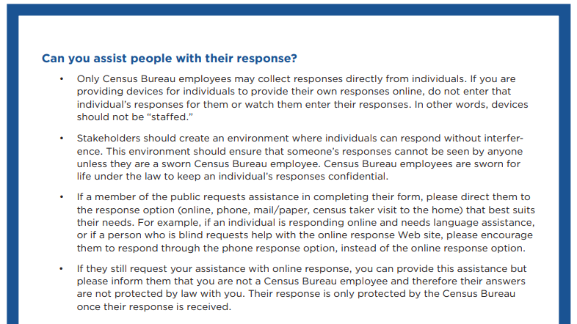
Can I Assist with Questionnaire Responses?
Yes, but...
You should not enter responses for individuals.
Only Census Bureau employees can offer confidentiality that is protected by federal law.
Notes:
It is important to remember that only the Bureau can offer confidentiality that is protected by law. The Bureau advises that community partners should not enter responses for individuals nor watch as they enter responses themselves.
If someone needs assistance, a good practice is to refer someone to the response method that best suits them. i.e.: someone with low literacy levels might prefer to complete their questionnaire over the phone.
Ultimately, if someone still requests help, you can provide assistance, but you should inform them that you are not a Census Bureau employee and their responses will not be protected by federal law with you.
For more information, please review the Census Bureau’s fact sheet: “Questions and Answers for Stakeholders Supporting the 2020 Census.” This sheet also contains best practices for Census kiosks.

Slide 27
Questions?
What we have covered so far:
Challenges to a Complete Count in NJ
Young Child Undercount
Notes:
Let’s take some time to answer any questions you may have. Just to recap, here are the subject areas we have covered so far.

Slide 28
How to Get Involved
Timeline
Outreach Activities
Groups to Engage
Notes:
Now that you are all Census experts, let’s discuss what you can do.

Slide 29
Action Timeline
Time is of the essence…
...so we’ve created a schedule of events for you!
Each month, select one (or all!) of the Census outreach activities. We will be sending reminders along the way.
Notes:
We’ve created a timeline for you! Each month, we will send reminders of some of the activities we are promoting during that time. You can participate in as many as you would like.

Slide 30
Snapshot of Outreach Activities
Late Feb.
Share toolkit and other materials with your staff, board and volunteers.
Early Mar.
Send email blasts, newsletters, and letters telling parents to look for their Census invitations in their mailboxes beginning mid-March.
Late Mar.
Use at least one Census Statistics in Schools activity in classrooms or at events (if appropriate).
Early Apr.
Host Census Days of Action--events that encourage Census completion on site.
Check your toolkit for more month-to-month activities from now through April 2020...
Notes:
Here is are examples of some of the activities we will be asking you to participate in.

Slide 31
How Can You Help?
Complete a commitment card and let us know!
Notes:
Using what you have learned today, try to brainstorm what you can do to make sure the families you serve understand the importance of counting their families in the Census. Take 15 minutes to read through the commitment card on the inside flap of your binder and fill it out.
Please leave it in the center of the tables. Don’t forget to take a picture of it so that you can remember what your response was.

Slide 32
10 years...
...is a long time. A two-year-old child missed in 2020 won’t have another chance at being counted until they are 12!
Notes:
Just a reminder--10 years worth of missed data can have a big impact. A two-year-old missed in 2020 won’t be counted again until they are 12.

Slide 33
Wrap-Up
Toolkit review
Questions
Exit Surveys
Notes:
We’ve provided everyone with toolkits--you will find the information from today (including this powerpoint) within the toolkit. Before we turn it over for questions, let’s take some time to discuss what is in your toolkits.

Slide 34
Ambassador Toolkit
Annotated Powerpoint Presentation
Background Information
Frequently Asked Questions
Sample Census Questionnaire
Q&A for Stakeholders Supporting the 2020 Census
Handouts
The 2020 Census is Coming… (ACNJ One Page Fact Sheet)
Census 2020: Count All Kids! (ACNJ Young Child Fact Sheet)
Household Living Scenarios: Who Counts Where? (ACNJ Household Fact Sheet)
Census 2020 Palm Card (ACNJ Checklist)
The 2020 Census and Confidentiality
Count Me! Census Stickers
Outreach Resources
Monthly Ambassador Activities
Sample Text/Email Messages
Census Bureau and Complete Count Committee Contacts
Guide: How to Host a Census Kiosk
We Count! Picture Book
Notes:
We have included some documents that will provide you with background information--including FAQs and some common household living scenarios that might help to answer questions from families. This section also contains a sample version of the questionnaire, as well as a fact sheet from the Census Bureau on common questions for stakeholders. This entire toolkit is also saved to your flash drives, so you can make copies directly from your computer.
You will have a copy of this powerpoint with the notes, as well as some useful handouts we’ve created at ACNJ in English and in Spanish. Additionally, we’ve included a document from the Census Bureau on confidentiality. A fun item--we’ve created stickers for you to hand out to children in your program to remind parents to include them.
Lastly, we have our outreach resources. These include our timeline of monthly activities, sample texts and emails, contacts at the Census Bureau and CCCs and the Network Analysis worksheet you completed today. We have also included information on the We Count! picture book in the toolkit. This is a resource designed to teach young children and adults on the importance of being counted in the Census. If you would like more information, visit the website listed in the toolkit.

Slide 35
Complete Your Exit Surveys
Your feedback is important.
Contact Us:
Peter Chen, Policy Counsel: pchen@acnj.org
Alana Vega, Kids Count Coordinator, avega@acnj.org
Daynne Glover, Policy and Outreach Associate, dglover@acnj.org
Notes:
In the front pocket of your toolkit binders, you will find an exit survey. Please take some time to complete the survey--it will help us improve our Census training program. Thank you! Please contact us if you have any questions.

