Slide 1
New Jersey Counts 2020
Notes:
Welcome!
ACNJ is coordinating the statewide, non-profit Census outreach effort.
Today’s presentation will give you some background on the Census and give you ideas of how to ensure a complete count.

Slide 2
Topics for Today:
Census 101
Census Operations
Challenges to a Complete Count in NJ
Tips for Community Leaders
How to Get Involved
Wrap-Up
Notes:
Here is the rough layout for today’s presentation.
First we will give you some background on the Census--what it is and why it is important
Then we will discuss some of the more technical aspects of Census operations--when they will start, what the form will look like, etc.
Then we will start to talk about some of the difficulties in obtaining a complete count--for the population at large.
We will break for questions in between sections, and then we will jump into a discussion of what you can do to ensure all residents are counted.
Finally, we will wrap up with final questions and we will ask you to complete a quick exit survey to get your feedback on today’s training.

Slide 3
Census 101
What is the Census? Why is it important?
Notes:
Let’s begin with some background on the Census

Slide 4
What is the Census?
The U.S. Census is a national survey conducted every ten years by the U.S. Census Bureau to count EVERY living person in the United States
People of all ages, races, and ethnic groups including citizens and non-citizens must be counted.
Notes:
Many of you have probably heard of the Census.
It is a constitutionally mandated count of every person living in the United States. Citizens, non-citizens, individuals who were formerly incarcerated, children...everyone. The count is conducted by the US Census Bureau.

Slide 5
Why is the Census Important?
The Census is so much more than just a head count. Its results will impact New Jersey for the next ten years.
Distribution of more than $22.7 billion in federal funds within NJ annually to support important programs and services like Medicaid, Head Start, schools, hospitals, roads, and more.
Helps determine New Jersey’s number of seats in the house of representatives, its number of votes in the electoral college, and our voting district boundaries.
Notes:
So, you know about the Census. But why is it important?
There are several different reasons. First, Census data are responsible for allocating billions of federal funds for important federal programs. More on some of those specific programs on the next slide.
Census data are also used to determine our governmental representation in Congress, the number of votes we have in the electoral college and how our voting districts are drawn. So Census data determine political power.
Not listed on this slide, but equally important:
Data are used for important planning purposes—we need to know where populations are growing so we can build more schools and highways.
And the traditional use—and how ACNJ uses Census data in our Kids Count work—these data show us important details about the communities in which we live.

Slide 6
Annual Federal Funding Received by NJ:
NJ FamilyCare*: | $9.6B
SNAP: | $1.2B
Section 8 Housing Vouchers: | $741M
Special Education Grants: | $370M
National School Lunch Program: | $261M
Head Start: | $164M
WIC: | $151M
Child Care: | $120M
$22.7 Billion
many more federal programs
*Includes Medicaid and State Children’s Health Insurance Program (SCHIP)
Notes:
As we mentioned before, NJ received 22.7 billion dollars through important federal programs in FY 2016. And here is just a snippet of some of the programs who rely on Census data to allocate funds. Medicaid, SNAP, Special Ed. Grants, Head Start, etc. These are important federal programs and they all depend on Census data.
If you’d like to see a longer list of programs—search for Andrew Reamer’s Counting for Dollars 2020, a project out of George Washington University, and look for the NJ fact sheet.

Slide 7
Census Operations
What questions will be asked?
When will I receive my questionnaire?
Notes:
Now you know a bit more about the Census--but I’m sure you have some technical questions. Like, what will the questionnaire look like, and when will I receive it?

Slide 8
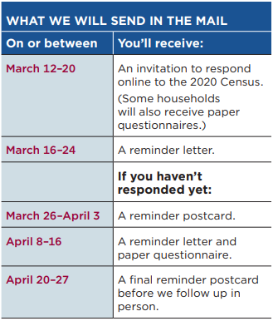
How Do I Complete My Questionnaire?
There will be three ways to complete the Census:
Online (including with a mobile device)
Over the phone
By mail
Notes:
2020 will mark the first year that respondents can complete their questionnaires online. On the right is a breakdown of the different types of mailings that will go out in the spring. Please note, with the exception of a few areas, most households will NOT receive a paper form until they have failed to respond to several mailed reminders from the Bureau. Alternatively, respondents can also complete their questionnaire over the phone.

Slide 9
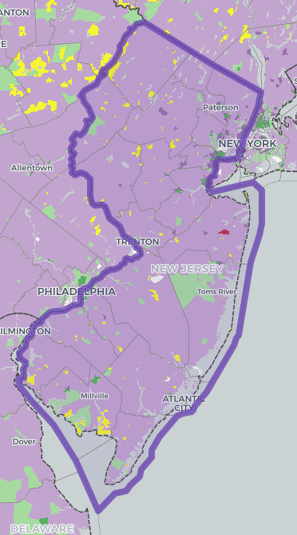
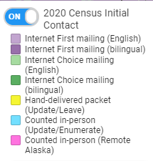
2020 Census Initial Contact
Visit www.censushardtocountmaps2020.us
to view how the Census will reach out to households in March 2020.
Notes:
Internet First--these households will initially receive an invitation in the mail to complete their Census online or over the phone (purple)
Internet Choice--these households will first receive an invitation in the mail to complete their Census online or over the phone, as well as a paper form (green)
Update/Leave--Census workers will hand deliver a packet to these households, which will include a paper form as well as instructions on how to complete the Census online or over the phone.

Slide 10
Census Operations Timeline
March 2020
April 2020
May 2020
June 2020
July 2020
Invitations will be sent to households with instructions on how to complete the questionnaire online or over the phone.
April 1st, 2020 is Census Day. Households should complete their questionnaires by the end of this month.
The Census Bureau begins visiting homes in person that haven’t responded online, over the phone or by mail.
The Census Bureau continues to visit homes who haven’t responded.
July 31, 2020 concludes Census field operations.
Encourage households to respond before the end of April 2020 to lessen the chances of a Census worker following up in person.
This period is known as self-response.
Notes:
Here is a rough timeline of peak Census operations. Beginning in early March, instructions will be mailed to households on how to complete the Census online or over the phone. There will be a series of subsequent reminders sent from March through April to homes that have not responded. Homes that do not respond right away will eventually receive a paper form in the mail. Some households will receive a paper form right away.
April 1, 2020 is Census day--an important reference point for the Bureau. It is recommended that families and households try to complete their questionnaires before the end of April. This is the best way to reduce the likelihood of a Census worker visiting them in person to collect their responses.
Then, beginning in May, Census workers will begin to canvas neighborhoods. This work will continue into July.
It is important to message to residents--if they would prefer not to have a Census worker visit their home, they should complete their questionnaire online or over the phone before the end of April. This will reduce their chances of an in person visit.

Slide 11
Door to Door Census Enumerators
Beginning in May, Census takers might be in your neighborhoods in order to follow up with households that have not responded.
How can you recognize a Census worker?
Census workers will wear a photo ID with:
a U.S. Dept. of Commerce watermark
an expiration date.
If you are ever unsure, contact the Census Bureau at 800-923-8282.
Notes:
Families should be informed that they may see Census workers canvassing their neighborhoods from May-July. They should know that Census workers will always wear a photo ID with an expiration date and a special U.S. Dept. of Commerce watermark.
If folks are concerned, contact the Census Bureau.

Slide 12
What Will The Census Ask?
Filling out the 2020 Census will be fast and easy!
The survey will take about 10 minutes to complete
Will collect basic information about you and your household:
For each household member:
Name
Age/Date of birth
Gender
Racial/ethnic background
Relationship to head of household
Other questions:
Owner/Renter questions
Notes:
The Census Bureau is framing this as something that is fast and easy to complete. The questionnaire should take about 10 minutes and it can be done on your own schedule.
The survey will ask basic questions--like your name, age, gender and race--of all residents within the household.

Slide 13
What WON’T the Census ask?
U.S. Census Bureau will NEVER ask for your:
Social security number
Money
Donations
Bank and credit card information
Beware of Scams!
If you suspect a scam, contact the Census Bureau. They can be reached at: 800-923-8282.
Notes:
It is important to note--the Census Bureau will NEVER ask for personal financial information. If you receive something in the mail that appears to be from the Bureau, but it is asking for your social security number or is saying you need to mail a check, proceed with caution. This is most likely a SCAM and should be reported to the Bureau immediately.

Slide 14
Language Support
In addition to English, people can respond to the Census online or by phone in 12 different languages:
Spanish
Chinese
Vietnamese
Korean
Russian
Arabic
The paper form will be available in English and Spanish.
Tagalog
Polish
French
Haitian Creole
Portuguese
Japanese
Notes:
It goes without saying that language support will be crucial for the upcoming Census. Nearly 1/3 of NJ residents speak a language other than English.
There will be online/phone support in 12 major languages—however, we all know that there are many more languages that are spoken out there. This is why coordinated local responses are important, which we will begin to discuss in the second portion of this training.
And the hard copy form will only be available in English or Spanish.
There will also be additional language assistance through the Bureau’s “language guides.” These will be available in 59 different languages.

Slide 15
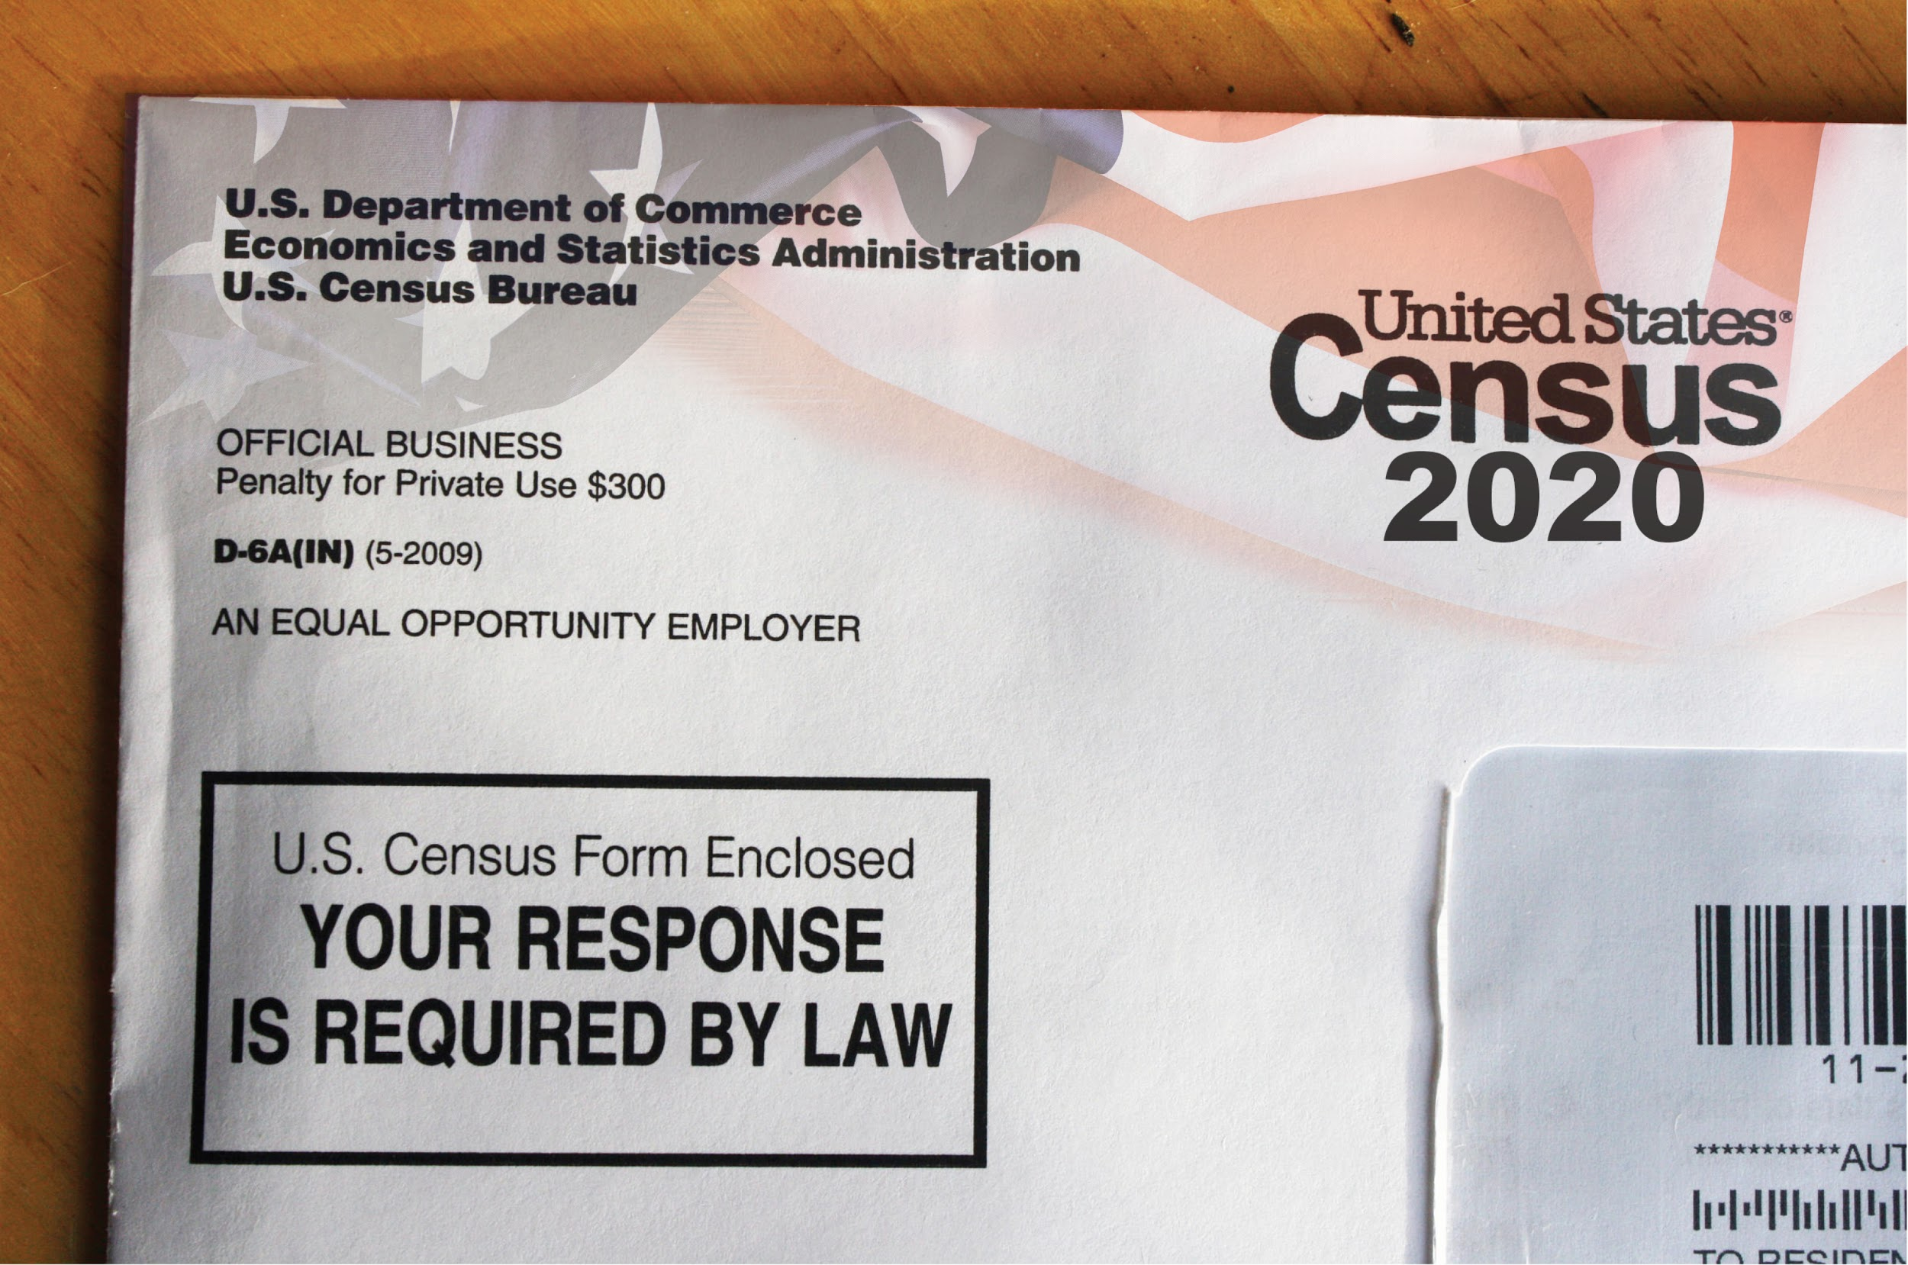
Questions?
What we have covered so far:
Census 101
Census Operations
Notes:
Let’s take some time to answer any questions you may have. Just to recap, here are the subject areas we have covered so far.

Slide 16
Challenges to a Complete Count in NJ
What is a hard-to-count (HTC) group?
Where are HTC groups concentrated?
Notes:
You may have heard that certain populations are hard-to-count--but you may not know the technical definition of HTC. We will cover that in this next portion.

Slide 17
Specific Challenges for 2020 Census
First Census to be primarily filled out online or on the phone
Distrust of government
Fewer staff than 2010 for in-person follow-up/coordination
Concentrations of hard-to-count populations throughout NJ
Notes:
While there are barriers to a complete count during every Census year, there are some specific obstacles for 2020.
As mentioned earlier, this is the first year that the Census will be able to completed online---and we know that many New Jerseyans are without internet or have limited access to internet.
There are also several other factors--an erosion of trust in the federal government along with mistrust of government surveys. There are fewer staff and resources for this census than in 2010. And, we also know that there are “hard-to-count” populations throughout our state.

Slide 18
NJ Hard-To-Count Groups
A Hard-To-Count (HTC) population refers to areas where a low percentage of households returned their 2010 Census forms.
Some populations are harder to count than others...
Children under 5
People of color (African Americans, Latinx, Asian Americans)
Non-English speakers
Immigrants
Renters
Notes:
What is a hard to count population? We are able to identify different neighborhoods, cities, or counties as HTC based on response rates to the 2010 Census. Those areas with a low percentage of households who self responded in 2010 are considered HTC. This isn’t a perfect science, as some areas have changed a great deal since 2010--but it’s a useful tool in identifying areas that might be at a greater risk of an undercount.
Some populations that are considered HTC are young children, people of color, immigrants, individuals who are highly mobile and renters.

Slide 19
What are the barriers to a complete count?
Some reasons people are missed in the count are:
They speak a language other than English
They mistrust or are fearful of the government
They live in a “complex household”
Their address wasn’t listed (think: multi-unit buildings)
They were not included on their household form
Notes:
The reasons some folks are missed in the Census count can be complicated, but some of the most common reasons include: language barriers and fear/mistrust of the government. These first two are more or less self-explanatory.
They may live in a complex household--which we will explain in further detail. Another reason may be because their address wasn’t listed--think of apartment buildings with an unregistered basement apartment--that address doesn’t technically exist, and may never receive a mailer.
And lastly, but most important for young children--some people are left of the form entirely by other members of their household.

Slide 20
What is a Complex Household?
This is a fancy way of referring to any household that isn’t solely comprised of parent(s) and related children.
Complex Households:
Multi-generational households
Households with multiple unrelated families
Children living in foster care placements
Notes:
To clarify a complex household is a technical way of referring to a household that doesn’t resemble the typical nuclear family.

Slide 21
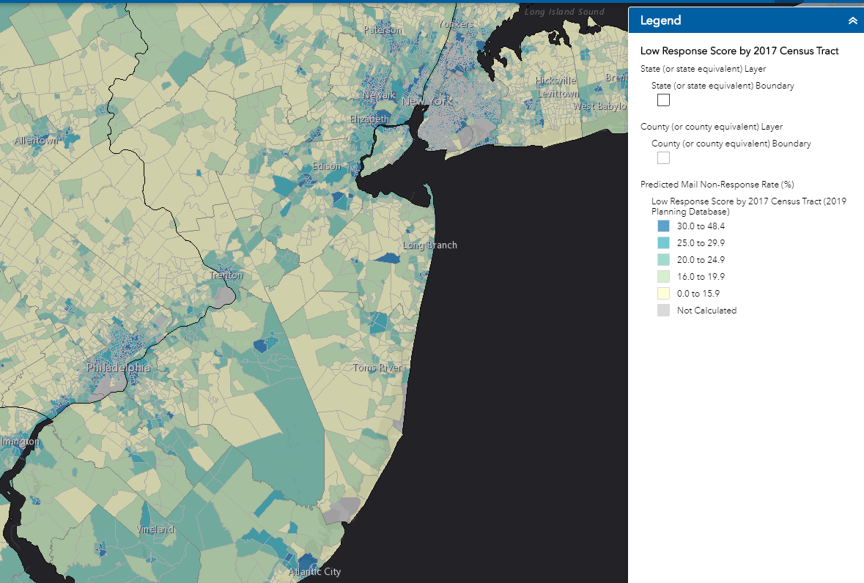
HTC areas where you live
To view interactive maps of your local hard-to-count areas, visit: www.census.gov/roam

Slide 22
Tips for Community Leaders
Who counts where?
Can I assist with responses?

Slide 23
Reassure Community Members:
The Census can be completed on your own schedule and should take about 10 minutes.
The Census is safe, confidential, and protected by federal law.
Notes:
Some tips when speaking to members of the community. First, the Census can be completed on your own schedule. If self responding, you get to choose the time to enter in the information into the computer or over the phone. As we’ve shown, the questionnaire asks for basic information, and it should take about 10 minutes. One caveat--for households that may be larger, the questionnaire will take longer to complete; particularly if the individual completing the questionnaire doesn’t know the ages or birthdates of all those residing in the home. It is important to let parents know what the form will include.
Second, remind community members that responses submitted on the Census questionnaire are protected by federal law. Census Bureau staff are prohibited from sharing information with other government agencies and law enforcement entities. Bureau employees face up to a $250,000 fine and/or 5 years in prison for violation of the law. For more information, review the Bureau’s confidentiality fact sheet.

Slide 24
Who Counts Where? Rule of Thumb:
Count people where they live or reside most of the time. If this is difficult to identify, then individuals should be counted where they are on April 1, 2020.
Notes:
Here are some important reminders about who to include on Census questionnaires.
The general rule of thumb is to include everyone living with you--even if they are not related to you. Newborns should be counted, even if they are still in the hospital on April 1, 2020. Children in placement should be counted wherever they reside the majority of the time or, if that is difficult to identify, wherever they reside on April 1, 2020.

Slide 25
Who Counts Where? Important Tips
Newborn still in the hospital on April 1?
Count them!
Living with unrelated individuals?
Count them!
Does a foster child live with you?
Count them!
Is your relative without a home and temporarily living with you on April 1, 2020?
Count them!
Group quarters enumeration
College dormitories
Correctional facilities
Nursing homes
Group homes
Residential treatment facilities
Residents counted by the facility
Notes:
Here are some different scenarios families and community members may have questions about.

Slide 26
Forgot to Include Someone?
You can complete the questionnaire a second time, the same as before, but this time you will add individuals who were missed.
The Census Bureau will later remove any duplicates.
Submit your corrected response online or over the phone using your address or the original code mailed to you by the Census Bureau.

Slide 27
Don’t forget the baby!
Notes:
One important note: We want to encourage residents broadly to complete the Census, but it is also important that we remind parents and caretakers NOT TO FORGET THEIR YOUNG CHILDREN! Much of the “get out the count” effort is focused on increasing the response rate--or making sure as many people complete their Census as possible. This will not solve the young child undercount. We need to make sure we educate and empower community members so that they understand why it is critical to include their baby or toddler--even if they are unrelated to the person completing the questionnaire.

Slide 28
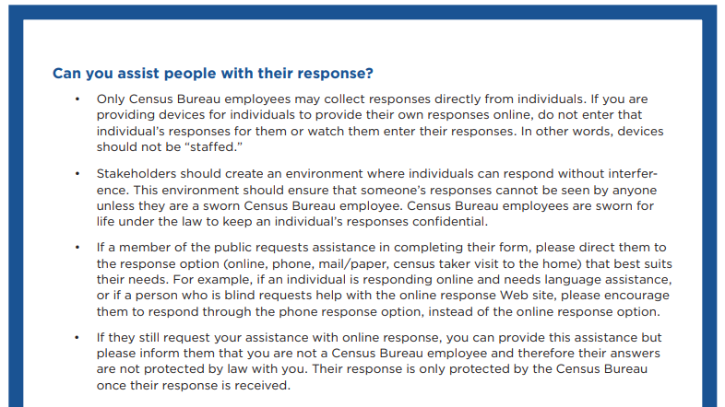
Can I Assist with Questionnaire Responses?
Yes, but...
You should not enter responses for individuals.
Only Census Bureau employees can offer confidentiality that is protected by federal law.
Notes:
It is important to remember that only the Bureau can offer confidentiality that is protected by law. The Bureau advises that community partners should not enter responses for individuals nor watch as they enter responses themselves.
If someone needs assistance, a good practice is to refer someone to the response method that best suits them. I.e.: someone with a low level of literacy might prefer to complete their questionnaire over the phone.
Ultimately, if someone still requests help, you can provide assistance, but you should inform them that you are not a Census Bureau employee and their responses will not be protected by federal law with you.
For more information, please review the Census Bureau’s fact sheet: “Questions and Answers for Stakeholders Supporting the 2020 Census.” This sheet also contains best practices for Census kiosks--it can be find in our Census toolkit, as well as on the Census Bureau’s website.

Slide 29
Questions?
What we have covered so far:
Challenges to a Complete Count in NJ
Tips for Community Leaders

Slide 30
How to Get Involved
Timeline
Outreach Activities
Groups to Engage

Slide 31
Action Timeline
Time is of the essence…
...so we’ve created a schedule of events for you!
Notes:
We’ve created a timeline in our Census toolkit--which can be accessed on our website! You can participate in as many activities as you would like.

Slide 32
Snapshot of Outreach Activities
Dec. ‘19
Invite Census Bureau to any community events you are involved in, especially around the holidays (pageants, fairs, toy drives, etc).
Jan. ‘20
Use at least one Census Statistics in Schools activity in classrooms (if appropriate)
Feb. ‘20
Add Census scripts to routine phone messages and mailings.
Mar. ‘20
Host a Census Action Day!
Visit our website for more month to month activities from now through April 2020...
Notes:
Here are examples of some of the activities we suggest in our toolkit.

Slide 33
How Can You Help?
Let’s brainstorm your action plan for Census 2020.
Notes:
Using what you have learned today, try to brainstorm what you can do to make sure the individuals you serve understand the importance of being counted in the Census.

Slide 34
Wrap-Up
Questions
Resources
Exit Surveys
Notes:
Thanks for participating in our brainstorming activity. Hopefully you all found it helpful.
Any lingering questions?

Slide 35
Resources
ACNJ Census Page (contains toolkit): www.census2020nj.org
Interactive maps:
CUNY Hard-to-Count Maps: www.censushardtocountmaps2020.us
Census ROAM: www.census.gov/roam
Apply for Census jobs: https://2020census.gov/en/jobs.html
Census Bureau Outreach Resources: https://2020census.gov/en/partners/outreach-materials.html
Statistics in Schools: https://www.census.gov/schools/

Slide 36
10 years...
...is a long time. A two-year-old child missed in 2020 won’t have another chance at being counted until they are 12!
Notes:
Just a reminder--10 years worth of missed data can have a big impact. A two-year-old missed in 2020 won’t be counted again until they are 12.

Slide 37
Complete Your Exit Surveys
Your feedback is important.
Contact Us:
Peter Chen, Policy Counsel: pchen@acnj.org
Alana Vega, Kids Count Coordinator, avega@acnj.org
Notes:
On each of your tables, you will find an exit survey. Please take some time to complete the survey--it will help us improve our Census training. Thank you! Please contact us if you have any questions.

