Slide 1
AGENDA
Model Overview
HealthySteps in New Jersey
The Evidence
Sustainability in New Jersey
Growth & Scale
1
© 2021 ZERO TO THREE. All rights reserved.

Slide 2
Learning Objectives
Increase your understanding of the role pediatric primary care plays in the early childhood services continuum and why team-based care is so important;
Learn about the HealthySteps model and its core components;
Learn about the first HealthySteps sites in New Jersey; and
Increase your understanding of the New Jersey HealthySteps initiative and the key policy and financing issues related to sustaining and scaling the model across the state.

Slide 4
An evidence-based, interdisciplinary pediatric primary care program that promotes nurturing parenting and healthy development for babies and toddlers, particularly in areas where there have been persistent inequities for families with low incomes and families of color.
What is HealthySteps?
HealthySteps Specialists are integrated into the pediatric team to provide short-term behavior/development consultation and referrals, intensive services when needed, and support practice screening efforts.
4
© 2021 ZERO TO THREE. All rights reserved.

Slide 5
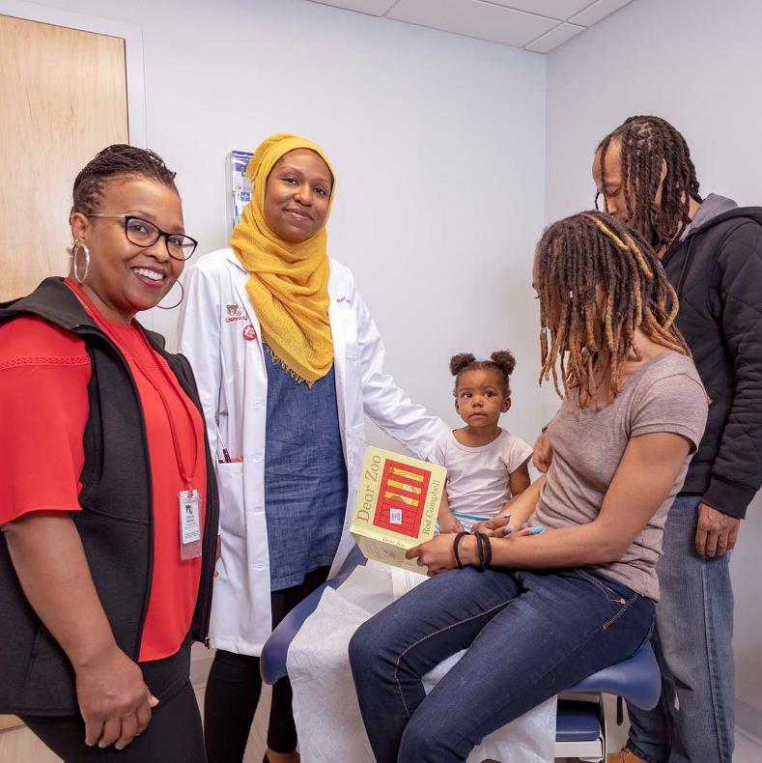
Pediatric Setting
Almost all families take their babies to see a pediatric primary care provider
ACCESS
TRUST
Parents trust their pediatric primary care provider
ACCEPTED
The pediatric office is a non-stigmatizing setting
FREQUENT
New parents attend 12-13 well-child visits within the first 3 years of life; half occur in the first year
5
© 2021 ZERO TO THREE. All rights reserved.

Slide 6
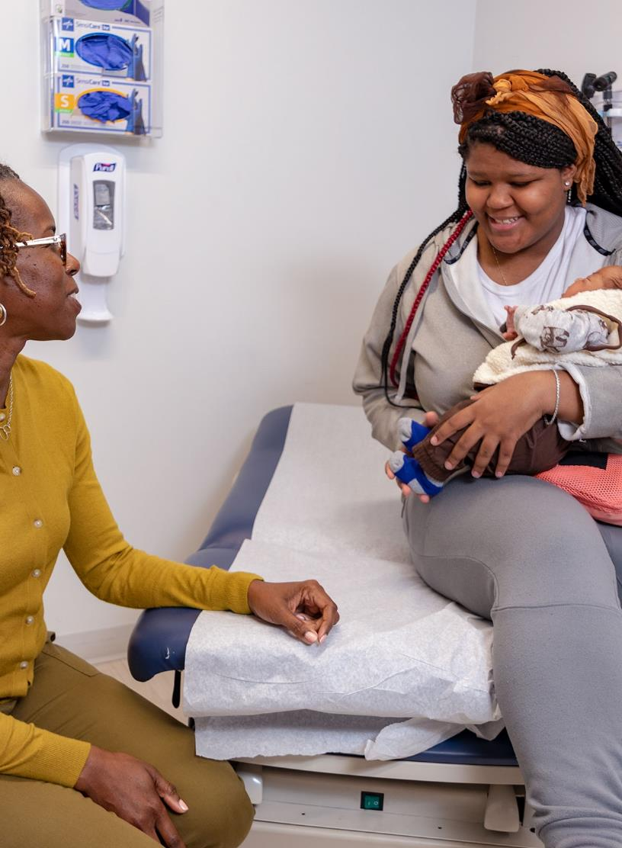
Child Developmental, Social-Emotional & Behavioral Screenings
Care Coordination & Systems Navigation
Screenings for Family Needs e.g., PPD, other risk factors, SDOH
Positive Parenting Guidance & Information
Core Components
Child Development Support Line
e.g., phone, text, email, online portal
Early Learning Resources
Child Development & Behavior Consults
Ongoing, Preventive Team-Based Well-Child Visits
6
Copyright © 2019 HealthySteps. All rights reserved.
6
© 2021 ZERO TO THREE. All rights reserved.

Slide 7
Tiers of Service Delivery
SERVICES INCLUDE
TIER 3
Ongoing, preventive team-based well-child visits
COMPREHENSIVE SERVICES
FAMILIES MOST AT RISK
Child development & behavior consults
Care coordination & systems navigation
Positive parenting guidance & information
Early learning resources
TIER 2
SHORT-TERM SUPPORT MILD CONCERNS
Child developmental, social-emotional & behavioral screenings
TIER 1
UNIVERSAL SERVICES
Screening for family needs -MATERNAL DEPRESSION -OTHER RISK FACTORS -SOCIAL DETERMINANTS OF HEALTH
Child development support line -PHONE, TEXT, EMAIL, ONLINE PORTAL
7
© 2021 ZERO TO THREE. All rights reserved.

Slide 8
June 2021
National Network
198
sites
ACROSS
25
1 – 4 sites
states
Washington, D.C. & Puerto Rico
5 – 10 sites
11 – 14 sites
15+ sites
8

Slide 9
HealthySteps in New Jersey
9
© 2021 ZERO TO THREE. All rights reserved..

Slide 10
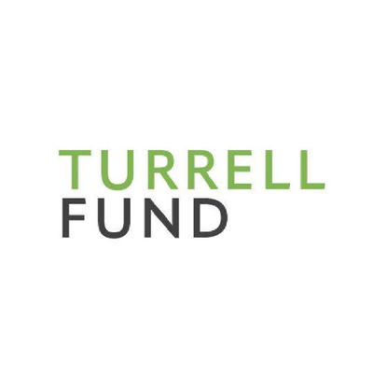
Investment in HealthySteps in New Jersey
Three foundations are joining Hackensack Meridian Health in supporting HealthySteps implementation at three sites in Bergen and Monmouth counties.

Slide 11
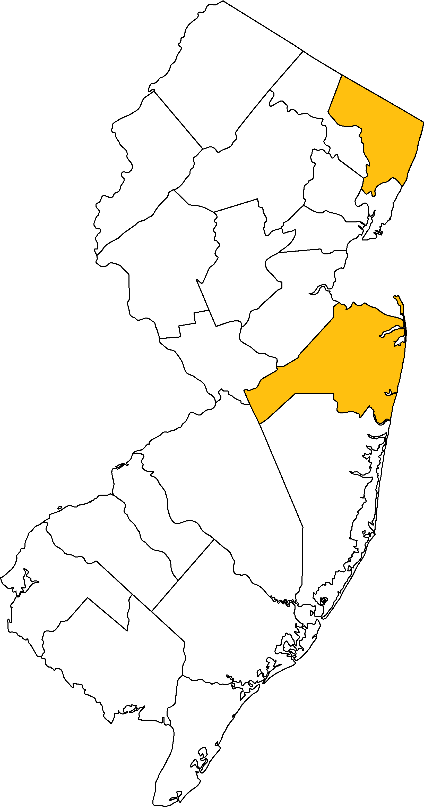
Hackensack Meridian Health Sites
Bergen County
Pediatric Academic Practice
Growing patient population – approximately 500 patients 0-3; 60% Medicaid
Pediatric residency program with up to 24 residents (2-3 per shift) and two preceptors
Monmouth County
Jane H. Booker Family Health Center
Approximately 1,400 patients 0-3 – virtually 100% Medicaid
9-10 rotating pediatricians (3 onsite each day); two to four pediatric residents on per day; one nurse practitioner
Neptune Pediatrics & Asbury Park Pediatrics
Two physical locations
Approximately 1,000 patients 0-3
67% Medicaid
Four pediatricians; one nurse practitioner; small number of residents and medical students

Slide 12
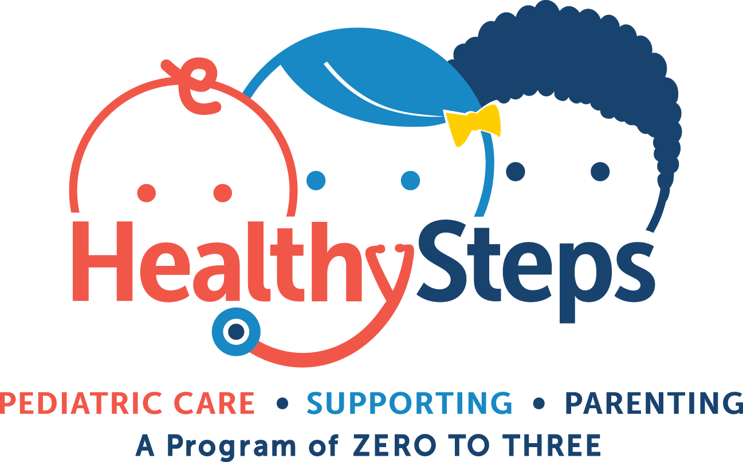
How Does HealthySteps Support Shared Goals?
Early Intervention
Universal early and frequent developmental screening
Warm handoffs to early intervention services
Systems navigation for families
Community-Based Services
Strengthens protective factors and address risk factors for abuse and neglect
Screening for maternal depression and parental needs
Partnership with Family Success Centers
Universal screening for autism and social-emotional/behavioral health
Parental needs screening and parental support
Care coordination and systems navigation
Family support for navigating to CSOC services
Maternal and Infant Health
Screening for maternal depression and family needs
Warm handoffs to home-visiting and perinatal programs
Anticipatory guidance for caregivers
Health Care
Cost savings associated with adult and pediatric interventions
Maternal and infant health support in primary care
Ensuring closed-loop referrals to specialty care

Slide 13
Screening and Connection to Services
Practice and Provider Impacts
Timely/ Continued Care and Vaccinations
Maternal Depression
HealthySteps Outcomes
Breastfeeding and Early Childhood Obesity Prevention
Social-Emotional Development
Child Safety and Risk Factors for Child Abuse and Neglect
Early Literacy and School Readiness
13
© 2021 ZERO TO THREE. All rights reserved.

Slide 14
Timely/Continued Care and Vaccinations
Timely and complete well-child visits
Timely and up-to-date vaccinations
Better continuity of care
Timely and Complete well-child visits
Children were up to 2.4x more likely receive timely well visits and were more likely to attend all of the first 10 recommended well-child visits^{1,6,10,11}
Timely and Up-To-Date Vaccinations
Children were up to 1.6x more likely to receive timely vaccinations and 1.4x more likely to be up to date on vaccinations by age 2^{1,6,10}
Better Continuity of Care
Continuity of care was significantly better for both total and well-child visits, and families were nearly twice as likely to remain with the practice through 20 months^{12,13}
14

Slide 15
CASE EXAMPLE

Slide 16
Screening and Connection to Services
Child Needs
Early identification of child and family needs
Improved connection to services
Children were 8x more likely to receive a developmental assessment and had significantly higher rates of developmental referrals^{1,2}
One HealthySteps practice with a dedicated family services coordinator quadrupled its Early Intervention successful referral rate³
Across a network of HealthySteps practices the median age of autism diagnosis for children who screened at the high-risk level was two years earlier than the national median⁴
FAMILY Needs
Families had significantly higher rates of nonmedical referrals, including referrals for child abuse or neglect, marital or family issues, and other social or environmental issues¹
Mothers had significantly higher rates of maternal depression referrals and were 4x more likely to receive information on community resources¹
A study in three HealthySteps practices found a successful referral rate of 88%²²
16

Slide 17
CASE EXAMPLE

Slide 18
Maternal Depression
Improved maternal depression screening and follow-up
Mothers more likely to share symptoms
Providers more likely to discuss postpartum depression
Fewer reported symptoms
Screening and follow-up for maternal depression
A quality improvement project in one HealthySteps practice increased maternal depression screening from 41% to 95% and maternal depression referral follow up from 49% to 67%^{3,14}
Mothers were significantly more likely to discuss their depressive symptoms and pediatric providers were significantly more likely to discuss postpartum depression with mothers^{1,6,10}
Mothers with depressive symptoms reported significantly fewer symptoms after receiving HealthySteps and that symptoms decreased at a faster rate than comparable mothers^{5,16}
18

Slide 19
CASE EXAMPLE

Slide 20
Social-Emotional Development
Higher Rates of Referrals
Higher referral rates for social-emotional concerns
Better understanding of infant development
Improved social-emotional development
Children “at risk” of social-emotional challenges had higher rates of referrals²
Better Understanding infant development
Families received more anticipatory guidance on child development topics (including temperament and social skills)¹⁰
Families demonstrated a significantly better understanding of infant social-emotional development⁵
Parents were significantly more likely to notice behavioral cues and provide age-appropriate nurturing^{1,17}
Improved Social-EMOTIONAL Development
Children whose mothers reported childhood trauma scored better on a social-emotional screening after receiving HealthySteps than comparable children⁹
20

Slide 21
CASE EXAMPLE

Slide 22
The Road to Scaling HealthySteps in NJ
SECURING PHILANTHROPIC SUPPORT TO BRING HEALTHYSTEPS TO NJ
IDENTIFYING SUSTAINABLE FUNDING
SCALING THE MODEL ACROSS NJ
Engaging relevant community partners and potential payers to explore partnership opportunities
Leveraging existing billing opportunities
Identifying and piloting new financing mechanisms
Tracking HealthySteps utilization and cost data to inform future sustainability efforts
Ongoing access to sustainable financing
Financial support for new site implementation
Ongoing partnership with state agencies and payers to integrate model into existing service delivery systems
Setting a new standard for pediatric primary care in NJ
Secured funding to support:
Finance training and implementation at initial sites
National Office and local partner sustainability activities
Hackensack research on impact of HealthySteps
WE ARE HERE
22
© 2021 ZERO TO THREE. All rights reserved.

Slide 23
Sustainability Pathways
Program fund through Department of Health or Department of Children and Families
Expand billing capabilities through Medicaid
Allow reimbursement for family therapy visits without a diagnosis or diagnosis of “at-risk” (e.g., CA, OR, MA)
Example: recent guidance from California’s Department of Health Care Services (DHCS)permits children enrolled in Medi-Cal (California’s Medicaid program) to receive family therapy without requiring the child to have a diagnosis if they have at least one specified risk factor (e.g., foster home placement, food insecurity, parent with depression)
Massachusetts Medicaid also now permits patients under the age of 21 who have had a positive behavioral screen to receive up to 6 psychotherapy or family psychotherapy sessions, without insurance carrier pre-authorization requirements, even if they do not meet the criteria for a behavioral health diagnosis.
Allow reimbursement for pediatric primary care preventive dyadic visit (e.g., CA, CO, OH)
California recently passed legislation that provides for dyadic behavioral health visits as of July 1, 2022. Dyadic behavioral health visits are provided for the child and caregiver or parent at medical visits, providing screening for behavioral health problems, interpersonal safety, tobacco and substance misuse and social determinants of health, such as food insecurity and housing instability, and referrals for appropriate follow-up care.
Establish an alternative payment model
Establish PMPM for practices that implement dyadic care programs like HealthySteps
Establish enhanced rate for well-child visit for team-based care

Slide 24
Questions? Thank you!
HealthySteps National Office
Pamela Winkler Tew, LSW, Senior Policy Analyst
ptew@zerotothree.org
Hackensack Meridian Health
Christina Rua-Pozo, LCSW, HealthySteps Specialist christina.ruapozo@hmhn.org
Ediza Lahoz Valentino, LSW, HealthySteps Specialist ediza.lhozvalentino@hmhn.org
Tierney Vagts, LSW, HealthySteps Specialist
tierney.vagts@hmhn.org

Slide 25
1. Guyer, B., Barth, M., Bishai, D., Caughy, M., Clark, B., Burkom, D., Genevro, J., Grason, H., Hou, W., Keng-Yen, H., Hughart, N., Snow Jones, A., McLearn, K.T., Miller, T., Minkovitz, C., Scharfstein, D., Stacy, H., Strobino, D., Szanton, E., & Tang, C. (2003). Healthy Steps: The first three years: The Healthy Steps for Young Children Program National Evaluation. https://ztt-healthysteps.s3.amazonaws.com/documents/139/attachments/2003_HS_National_Evaluation_Report.pdf?1539967. 2. Hughes, S., Herrera-Mata, L., & Dunn, J. (2014). Impact of Healthy Steps on developmental referral rates. Family Medicine, 46(10), 788-791. 3. The HealthySteps National Office. (2020). Embracing Growth: 2019 Annual Report. https://ztt-healthysteps.s3.amazonaws.com/documents/309/attachments/Embracing_Growth_2019_Annual_Report.pdf?1596829170. 4. Mitchell, J., Levine, S., & German, M. (2020, April 29 - May 6) Screening for Autism at 18 months in primary care and age of diagnosis of Autism Spectrum Disorder [Poster Session]. Pediatric Academic Societies. https://plan.core-apps.com/pas2020/abstract/cb127010d9c607e3e85e9f1586f1b73e. Note: this conference was cancelled due to COVID-19. 5. Johnston, B.D., Huebner, C.E., Tyll, L.T., Barlow, W.E., & Thompson, R.S. (2004). Expanding developmental and behavioral services for newborns in primary care: Effects on parental well-being, practice and satisfaction. American Journal of Preventive Medicine, 26(4), 356–366. 6. Johnston, B.D., Huebner, C.E., Anderson, M.L., Tyll, L.T., & Thompson, R.S. (2006). Healthy Steps in an integrated delivery system: Child and parent outcomes at 30 months. Archives of Pediatrics & Adolescent Medicine, 160(8), 793–800. 7. Herbst, R.B, Ammerman, R.T., Perry, S.P., Zion, C.E., Rummel, M.K., McClure, J.M., & Stark, L.J. (2019). Treatment of maternal depression in pediatric primary care. Clinical Pediatrics, 58(13), 1436-1439. 8. Gross, R.S., Briggs, R.D., Hershberg, R.S., Silver, E.J., Velazco, N.K., Hauser, N.R., & Racine, A.D. (2015). Early child social-emotional problems and child obesity: Exploring the protective role of a primary care-based general parenting intervention. Journal of Developmental and Behavioral Pediatrics, 36(8), 594–604. 9. Briggs, R. D., Silver, E.J., Krug, L.M., Mason, Z.S., Schrag, R.D.A., Chinitz, S., & Racine, A D. (2014). Healthy Steps as a moderator: The impact of maternal trauma on child social-emotional development. Clinical Practice in Pediatric Psychology, 2(2), 166–175. 10. Buchholz, M., & Talmi, A. (2012). What we talked about at the pediatrician’s office: Exploring differences between Healthy Steps and traditional pediatric primary care visits. Infant Mental Health Journal, 33(4), 430–436. 11. Wolcott, C., Buchholz, M., Ehmer, A., Stein, R., & Talmi, A. (2017, Nov 29 - Dec 2) Adversity and well-child visit attendance: The role of a preventative primary care intervention [Poster Session]. ZERO TO THREE Annual Conference, San Diego, CA. 12. Niederman, L.G., Schwartz, A., Connell, K.J., & Silverman, K. (2007). Healthy Steps for Young Children Program in pediatric residency training: Impact on primary care outcomes. Pediatrics, 120(3), e596–e603. 13.Minkovitz, C. S., Strobino, D., Mistry, K.B., Scharfstein, D.O., Grason, H., Hou, W., Ialongo, N., & Guyer, B. (2007). Healthy Steps for Young Children: Sustained results at 5.5 years. Pediatrics, 120(3), e658–e668. 14. Preliminary data from the HealthySteps Outcome Pilot Study. 15. Fried, E., Hernandez, C., Ringwood, H., & Tomcho, M. (2019, Oct 2 - Oct 5) Creative solutions to postnatal Care: Mom-baby dyad visits in a pediatric setting [Conference Session]. ZERO TO THREE Annual Conference, Hollywood, FL. 16. Kearns, M.A., Fischer, C., Buchholz, M., & Talmi, A. (2016, Dec 7 - 9) More than the blues? Comparing changes in pregnancy related depression symptoms based on enrollment in Healthy Steps [Poster Session]. ZERO TO THREE Annual Conference, New Orleans, LA. 17. Caughy, M.O., Huang, K., Miller, T., & Genevro, J.L. (2004). The effects of the Healthy Steps for Young Children program: Results from observations of parenting and child development. Early Childhood Research Quarterly, 19(4), 611–630. 18. Piotrowski, C.C., Talavera, G.A., & Mayer, J.A. (2009). Healthy Steps: A systematic review of a preventive practice-based model of pediatric care. Journal of Developmental and Behavioral Pediatrics, 30(1), 91–103. 19. Davis, A., Vivrette, R., Carter, T., Eberhardt, C., Edwards, S., Connors, K., & Reavis, K. (in press). Impact of an approach to integrated care for young children in low-income urban settings: Lessons from the Perspectives of Primary Care Clinicians. Journal of Clinical Practice in Pediatric Psychology. 20. Herbst, R.B., Khalsa, A.S., Schlottmann, H., Kerrey, M.K., Glass, K., & Burkhardt, M.C. (2019). Effective implementation of culturally appropriate tools in addressing overweight and obesity in an urban underserved early childhood population in pediatric primary care. Clinical Pediatrics, 58(5), 511-520. 21. Buchholz, M., Burnett, B., Margolis, K.L., Millar, A., & Talmi, A. (2018). Early childhood behavioral health integration activities and HealthySteps: Sustaining practice, averting costs. Clinical Practice in Pediatric Psychology, 6(2), 140-151. 22. German, M., et al. (2021). Impact of Community Healthy Workers on Community Referrals with an Integrated Primary Care Setting. Manuscript in preparation.
HealthySteps Outcomes Citations
25
© 2021 ZERO TO THREE. All rights reserved..

